Slide 1
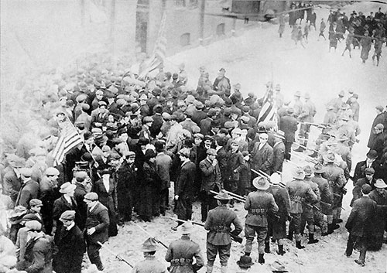
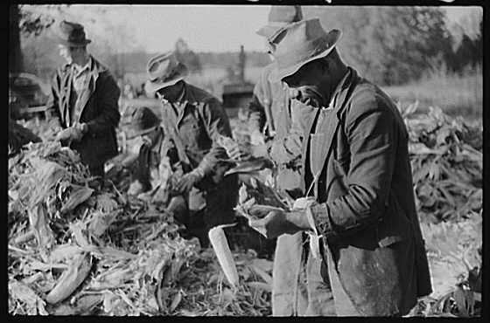
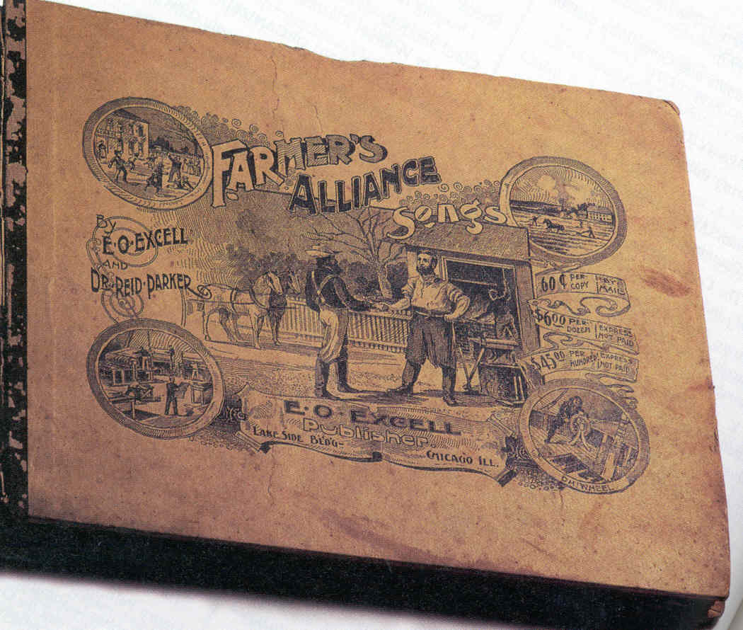
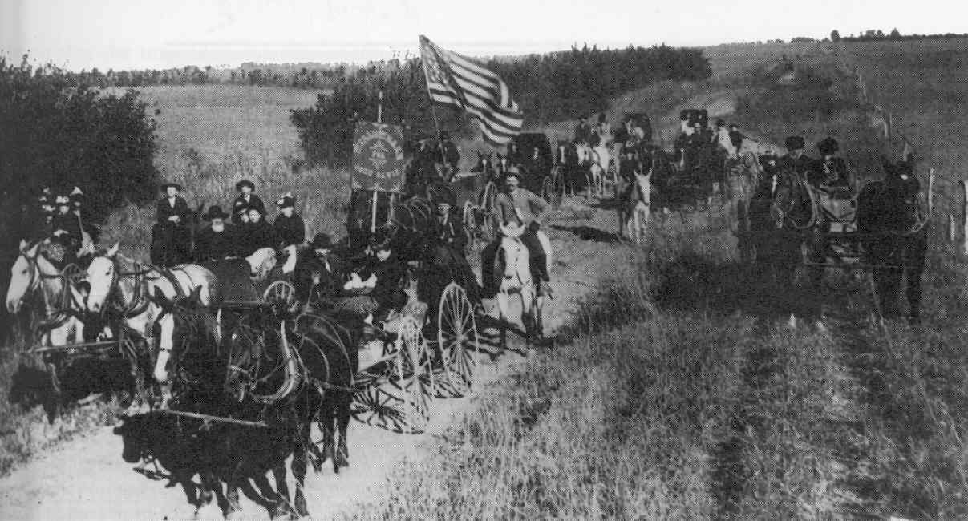
Farmers Propose Some Alternatives
Notes:
Why were the farmers mad to start with?

Slide 2
Review
What problems were farmers facing during the late nineteenth and early twentieth centuries?

Slide 3
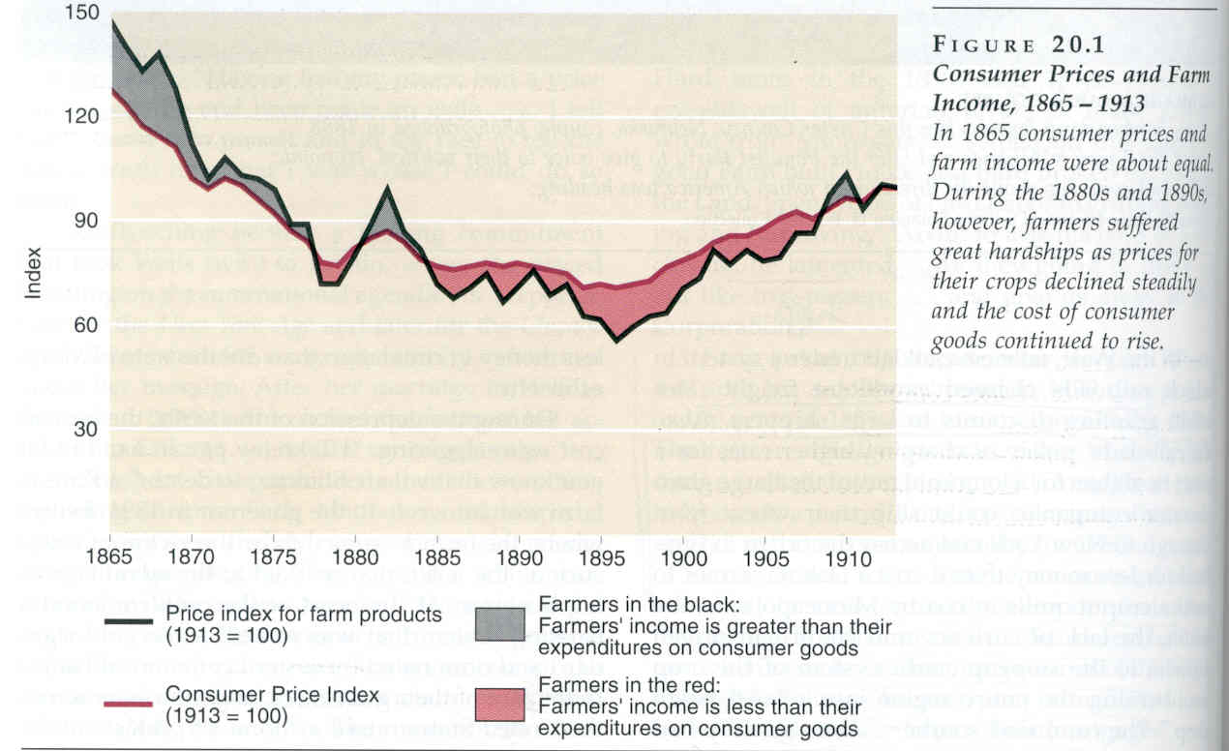
Status of Farmers at the End of the Century
Deflation - falling prices for crops.
High freight rates for farmers vs. discounts for large shippers.
Notes:
1870, wheat sold for a dollar a bushel
1885, .80 and .60 in 1890s
Farmer received .35
Cotton dropped from .15 to .05 a pound
Corn started at .45 and fell to .30 a bushel by the 1890s

Slide 4
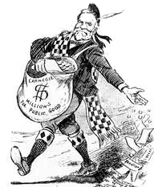
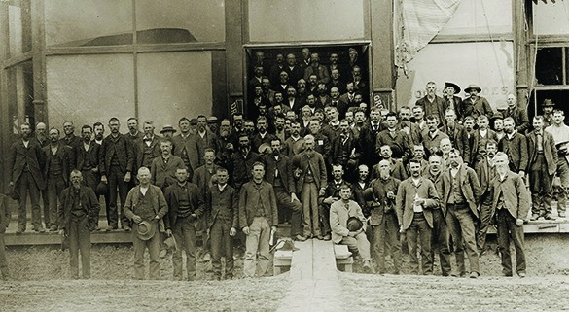
The Gospel of Cooperation
The Weakness of Individuals
Acting Alone
(The Gospel of Wealth: Carnegie)
v.
The Power of Farmers
Acting Together
(The Gospel of Cooperation)

Slide 5
The Farmers’ Plan
Pool crops to get a higher price.
Buy in bulk to get lower prices.
Negotiate with banks as a group to get lower interest rates.
By-pass middlemen

Slide 6
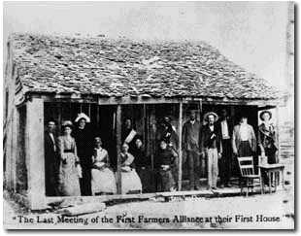
Spreading the Gospel of Cooperation
Farmers’ Alliances: Late 1880s
From Texas to the Great Plains and the South
Membership numbers rise. By 1889:
* Kansas- 50,000
* Georgia- 100,000
* Tennessee- 125,000
By 1889, over 4 million members.

Slide 7
From Cooperatives to Politics
Farmers make up over 50% of the population. And if they could also get the workers on their side…!
The People’s Party to challenge the Democrats and the Republicans.

Slide 8
The People’s Party Platform
The secret ballot
Direct election of senators
One-term presidents
The system’s been corrupted by elites; the people should be in charge.

Slide 9
The People’s Party Platform
The eight-hour day
Expansion of the money supply with silver
Unite with workers
Reduce the value of the dollar

Slide 10
The People’s Party Platform
Railroads publicly rather than privately owned.
Banks publicly rather than privately owned.
Return railroad land to the people.

Slide 11
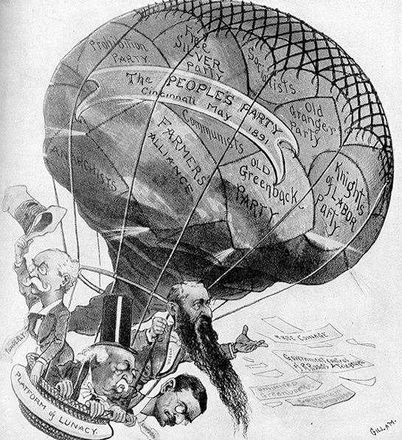
The Election of 1892
Republican candidate: Benjamin Harrison
(incumbent)
Democratic candidate: Grover Cleveland
Both parties attacked the People’s Party!

Slide 12
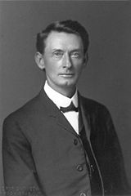
Fear in the South
Segregation and racism.
Some Populists (a minority) suggest poor whites and blacks have more in common than poor whites have with elite whites.
Poor whites’ reaction?
Massive election fraud.
* Tom Watson
“You are kept apart that you may be separately fleeced of your earnings. You are made to hate each other because upon that hatred is rested the keystone of the arch of financial despotism which enslaves you both. You are deceived and blinded that you may not see how this race antagonism perpetuates a monetary system which beggars both.”

Slide 13
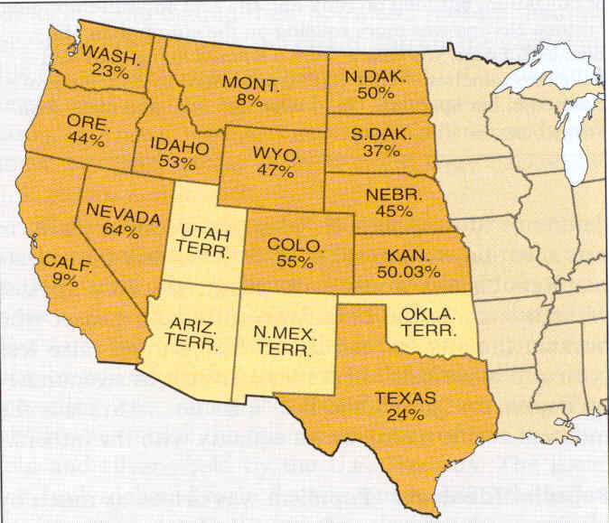
Western Movement
1892 Electoral Victories
  3 governors, 10 representatives, 5 senators.
  Their candidate for president received over 1 million votes (8.5% of total) and 22 electoral college votes
(Cleveland won the presidential election.)

Slide 14
After the Election
Best showing by a new party since the Republicans.
1893- depression.
* 25% unemployment
* People’s Party growing in popularity

Slide 15
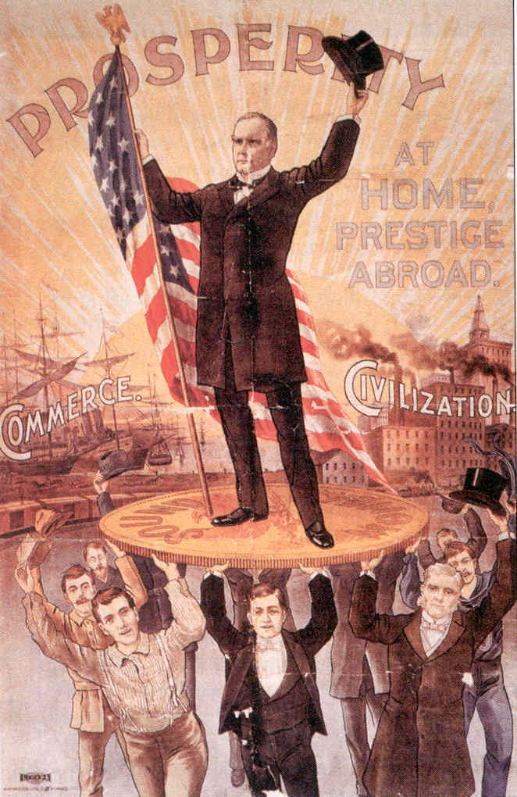
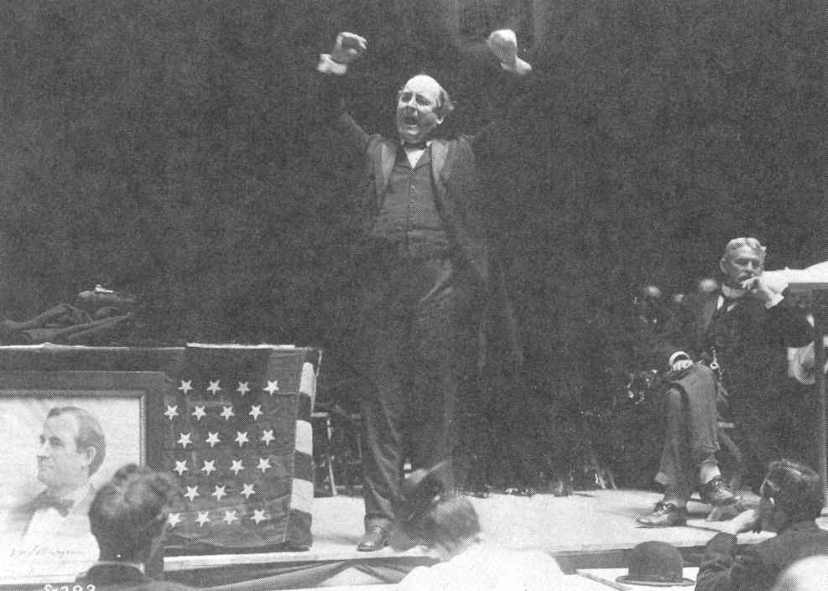
The Election of 1896
Republicans nominated William McKinley.
Democrats in a bind.
Cleveland = Depression
William Jennings Bryan:
single issue campaign- expand the money supply

Slide 16
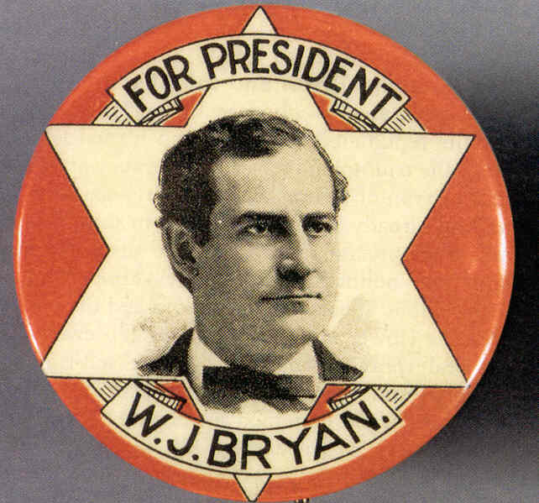
The Populists Face a Dilemma
Go with Bryan?
Pick their own candidate?

Slide 17
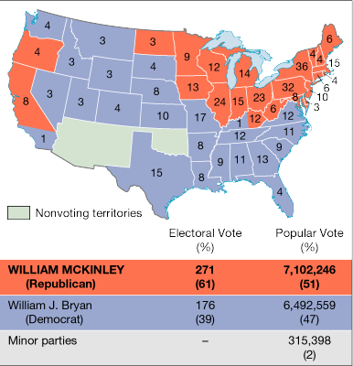
The Election of 1896, by States
But Bryan didn’t win.
The danger of single issue campaigns.

